Slide 1
Emerging technology meetups
Series #2
Blockchain
December 14, 2018

Slide 2
Blockchain: outline and schedule
BACKGROUND
PRACTICAL BLOCKCHAINING
How does blockchain work?
Hyperledger Perishable Goods
Deploying Really Smart Contracts
Under the Hood with Details
Motivations/Demonstrations
25 minutes
5 minutes
20 minutes
20 minutes
20 minutes

Slide 3
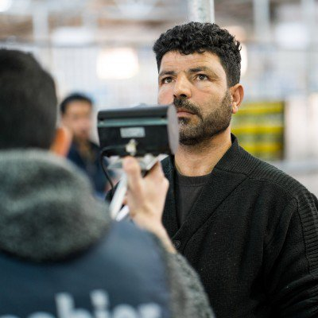
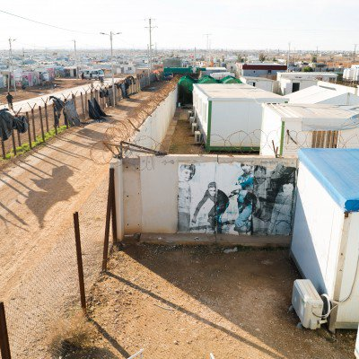
Motivations: Fair Trade
How do we conduct trade:
Across borders?
In low infrastructure environments?
In trustless environments?
Securely
Conveniently
Privately
“Though Bassam may not know it, his visit to the supermarket involves one of the first uses of blockchain for humanitarian aid. By letting a machine scan his iris, he confirmed his identity on a traditional United Nations database, queried a family account kept on a variant of the Ethereum blockchain by the World Food Programme(WFP), and settled his bill without opening his wallet.”
Source: MIT Technology Review, April 2018

Slide 4
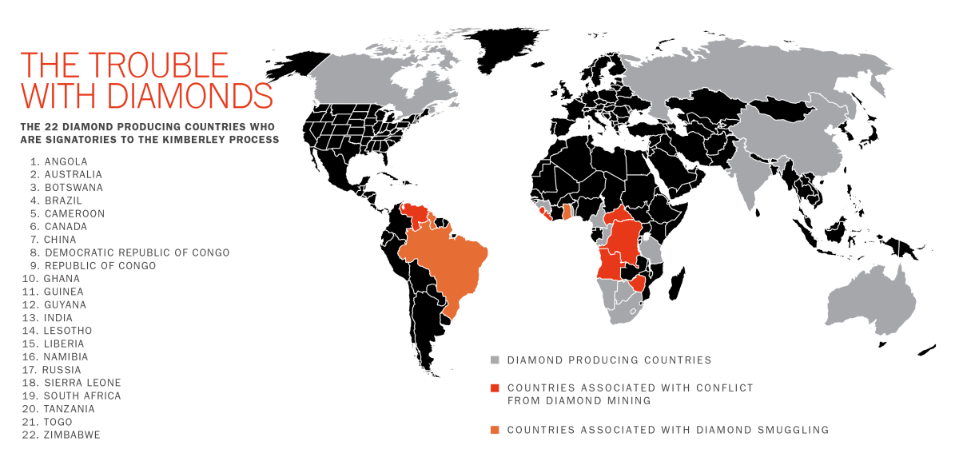
Motivations: Supply Chain
Complex supply chain requirements
Global Distribution of Peers
Differing Peer Interaction Modes
Public/Private
Security
Access Control
Permissions
Provenance
Where did it come from?
Immutability
Once committed, persistent record
Source: Time Magazine
https://www.youtube.com/watch?v=hHkc-DH0ep4
https://www.bloomberg.com/news/videos/2018-05-10/de-beers-blockchain-video
https://www.youtube.com/watch?v=oOywU_rXgFE

Slide 5
Blockchain: How does this work?
Revolutionary ideas
De-Centralized tracking and storage
Implicit trust
No intermediaries
https://www.youtube.com/watch?v=3xGLc-zz9cA

Slide 6
Blockchain Timeline
1991 Digital Timestamp – never caught on but intended to control document tampering
1993 Cypherpunk Manifesto – computing luminaries embrace privacy
2008 Bitcoin explodes onto the scene
Anonymous inventor – Satoshi Nakamoto (there have been several claimants)
Solves double spending, introduces blockchain
Bitcoin miners begin supporting system operation (https://blockexplorer.com/)
Rise of digital currency exchanges (CoinBase, Poloniex, Kraken, ShapeShift, Gemini)
2013 Ethereum (2013) creates DAO (2016) – De-centralized Autonomous Organizations
Significant generalization
Tokens for shares
Crowd sourcing
Smart Contracts
DAO is hacked, loses 1/3 of it’s value
Code anti-pattern exploited
Within the transaction acceptance period (27 days)
http://hackingdistributed.com/2016/06/18/analysis-of-the-dao-exploit/
2015 Linux Foundation creates Hyperledger Fabric
IBM produces Hyperledger Composer, specifically for permissioned blockchains
Abandons cryptocurrency applications
Significant ‘respectability’ improvement
2018 Large-scale applications and investment
Dubai Smart City component, Blockchain City
Maersk, DeBeers, major banks

Slide 7
Disruption: Centralization meets De-Centralization
Banks, Credit Cards, Credit Agencies, Healthcare
Google, MS, IBM, Oracle, Nomads, Hackers
Centralized definition and control of data, process, logic
Transactional Monetization
Corporate share ownership
Business logic owned by organization
Security by declaration, although…
Anthem breach
Equifax breach
Trust in People
First State Bank and Trust
Frustratingly inconvenient at times
How many times do I have to confirm…?
Words-Actions Mismatch
Digital Currencies are seditious, won’t work, are a Ponzi scheme
…but we just invested $50B in digital currencies and tech
Decentralized Apps (Dapp’s) & Decentralized Autonomous Organizations (DAO’s)
Software Entity
Digital shares in tokens/coins
Corporate decisions by voting
Business logic by agreement between parties
Smart Contracts
Security by design, although…
Ethereum DAO hacked, losing 1/3 of its value
Anti-Pattern, Recursive, Re-entry exploit
Trust in Code (Trust-less)
Cryptographic trust
Meta Convenience
Everything anonymous, nothing hidden
Political, Social, Environmental Passions
Voting, Resource Sharing,
Provenance Tracking
Diamonds, Food

Slide 8
What was the DAO?
The DAO was intended to operate as "a hub that disperses funds (currently in Ether, the Ethereum value token) to projects". Investors received voting rights by means of a digital share token;^{[26]} they vote on proposals that are submitted by "contractors" and a group of volunteers called "curators" check the identity of people submitting proposals and make sure the projects are legal before "whitelisting" them.^{[6]} The profits from the investments will then flow back to its stakeholders.^{[3]}
^{(Source: Wikipedia – The DAO)}
https://blog.slock.it/the-history-of-the-dao-and-lessons-learned-d06740f8cfa5

Slide 9
Corporate vs DAO
Corporate Organization
Decentralized Autonomous Organization
Business is set of policies
People execute
CXO/Board Controls
Location is private data center, permissioned participants
Security is critical
Centralized data
Centralized control
Heavy use of IT/proprietary
Homogeneous environments
Business reduced to code
Anyone can check it
Investors vote
Location is worldwide, potentially permissionless
Security is critical
Structured access control
Cryptographic insurance
By design, immutable records
Heavy use of distributed computing/open source
Heterogenous environments

Slide 10
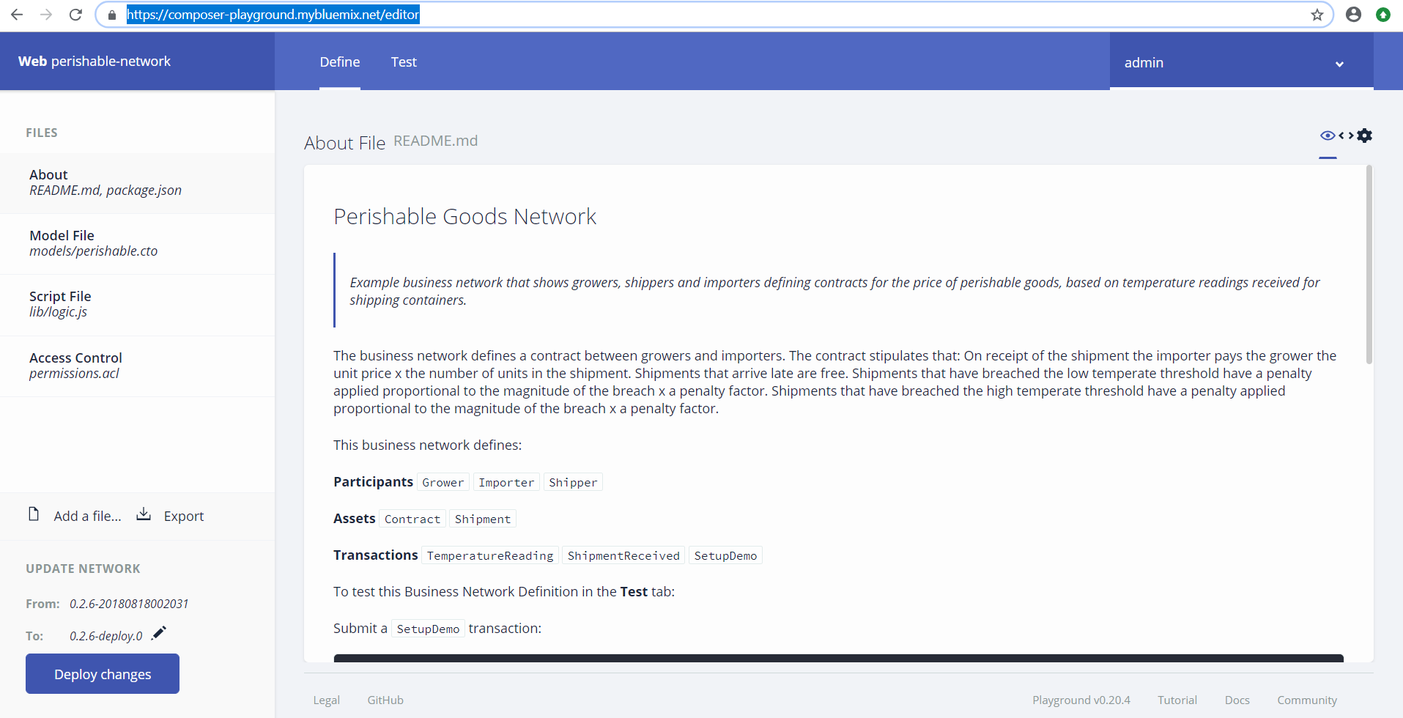
Blockchain: Demonstration
https://composer-playground.mybluemix.net/editor

Slide 11
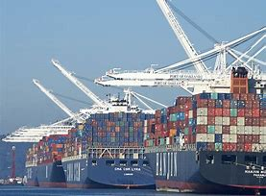
Demonstration: Hyperledger composer

Slide 12
Blockchain: (Really) Smart Contracts
Accord Project - https://docs.accordproject.org/
Focused on templating legal contracts
Clause - https://clause.io/
Delivering connected contracting to blockchain
The implementation environment
IBM – https://www.ibm.com/cloud/blockchain-platform
Deployment environment – bluemix/cloud
Hyperledger Composer – blockchain implementation

Slide 13
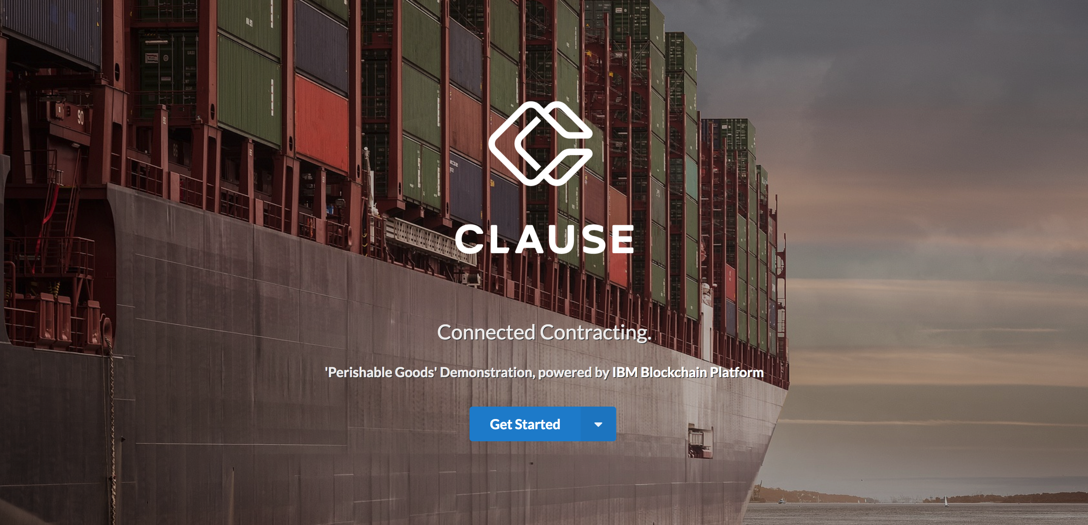
Demonstration:Connected Contracts
https://vimeo.com/294769622

Slide 14
Under the Hood
Details
Details
Details…

Slide 15
Ledger: Participants
ID: Farmer
{
"$class": "org.acme.shipping.perishable.Grower",
"email": "farmer@email.com",
"address": {
"$class": "org.acme.shipping.perishable.Address",
"country": "USA"
},
"accountBalance": 1500
}
ID:Shipper
{
"$class": "org.acme.shipping.perishable.Shipper",
"email": "shipper@email.com",
"address": {
"$class": "org.acme.shipping.perishable.Address",
"country": "Panama"
},
"accountBalance": 30000
}
Ledger
Ledger
Ledger
ID: Importer
{
"$class": "org.acme.shipping.perishable.Importer",
"email": "supermarket@email.com",
"address": {
"$class": "org.acme.shipping.perishable.Address",
"country": "UK"
},
"accountBalance": 19500
}
Using the blockchain and represented in
the blockchain.

Slide 16
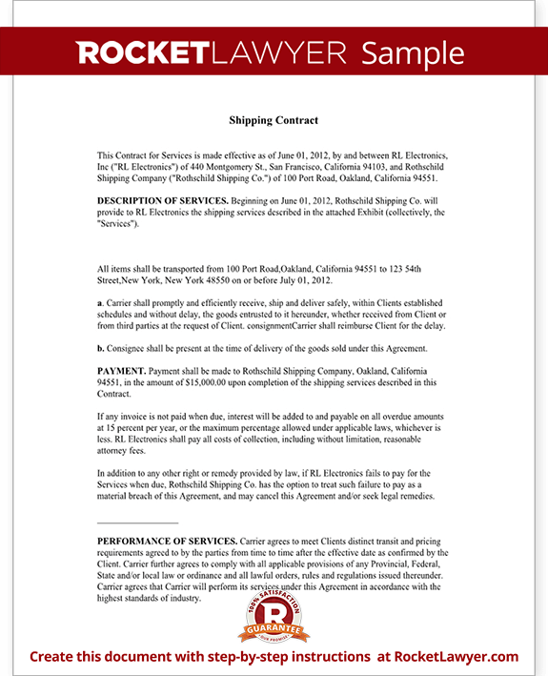
Ledger: Assets
{
"$class": "org.acme.shipping.perishable.Contract",
"contractId": "CON_001",
"grower": "resource:org.acme.shipping.perishable.Grower#farmer@email.com",
"shipper": "resource:org.acme.shipping.perishable.Shipper#shipper@email.com",
"importer": "resource:org.acme.shipping.perishable.Importer#supermarket@email.com",
"arrivalDateTime": "2018-11-14T19:52:42.079Z",
"unitPrice": 0.5,
"minTemperature": 2,
"maxTemperature": 10,
"minPenaltyFactor": 0.2,
"maxPenaltyFactor": 0.1
}
As data
The Contract
{
"$class": "org.acme.shipping.perishable.Shipment",
"shipmentId": "SHIP_003",
"type": “BANANAS",
"status": "CREATED",
"unitCount": 0,
"contract": "resource:org.acme.shipping.perishable.Contract#CON_001"
}
As data
You are here.
The Shipment

Slide 17
Ledger: Transactions
Raw Data
{
"$class": "org.acme.shipping.perishable.TemperatureReading",
"centigrade": 0,
"shipment": "resource:org.acme.shipping.perishable.Shipment#SHIP_003"
}
{
"$class": "org.acme.shipping.perishable.TemperatureReading",
"centigrade": 0,
"shipment": "resource:org.acme.shipping.perishable.Shipment#SHIP_003",
"transactionId": "6b117b2c-682c-4c12-81c5-7fcf4daf56b3",
"timestamp": "2018-11-14T19:00:13.999Z"
}

Slide 18
Ledger: Transaction Details
Model
/**
* An abstract transaction that is related to a Shipment
*/
abstract transaction ShipmentTransaction {
--> Shipment shipment
}
/**
* An temperature reading for a shipment. E.g. received from a
* device within a temperature controlled shipping container
*/
transaction TemperatureReading extends ShipmentTransaction {
o Double centigrade
}
Code: Using Node’s Async/Await – Syntactic Sugar for Promises
/**
* A temperature reading has been received for a shipment
* @param {org.acme.shipping.perishable.TemperatureReading} temperatureReading - the TemperatureReading transaction
* @transaction
*/
async function temperatureReading(temperatureReading) { // eslint-disable-line no-unused-vars
const shipment = temperatureReading.shipment;
console.log('Adding temperature ' + temperatureReading.centigrade + ' to shipment ' + shipment.$identifier);
if (shipment.temperatureReadings) {
shipment.temperatureReadings.push(temperatureReading);
} else {
shipment.temperatureReadings = [temperatureReading];
}
// add the temp reading to the shipment
const shipmentRegistry = await getAssetRegistry('org.acme.shipping.perishable.Shipment');
await shipmentRegistry.update(shipment);
}
{
"$class": "org.acme.shipping.perishable.TemperatureReading",
"centigrade": 0,
"shipment": "resource:org.acme.shipping.perishable.Shipment#SHIP_003"
}

Slide 19
What is a blockchain?
Official Lunch Ledger
Ted pays Alice $20
Alice Pays Mary $30
Bob pays Alice $10
Official Lunch Ledger
Ted pays Alice $20
Alice Pays Mary $30
Bob pays Alice $10
Break it up
Ted
Alice
Distributed, Replicated Ledger
Ledger can be arbitrarily large – break it up into discrete blocks
Give all participants (nodes, peers) a copy
Implemented as a set of interconnected blocks containing –
Verified transactions
Consensus guarantee
Blocks contain a lineage of predecessors
Storing the ‘hash’ of the previous block
Official Lunch Ledger
Ted pays Alice $20
Alice Pays Mary $30
Bob pays Alice $10
Official Lunch Ledger
Ted pays Alice $20
Alice Pays Mary $30
Bob pays Alice $10
Mary
Bob
Prev Block: 10101010000100011011001…
ID | Description, Amt, Sign | Date/Time
100100110000… | Mary -> Bob, $30, Mary | 11/28/18, 3:00 PM EST
001001010101… | Bob -> Alice, $20, Bob | 11/28/18, 3:01 PM EST
Consensus Guarantee: 792139487123098712
Hash of Block 4343
4344
4345

Slide 20
How is a blockchain managed? A Protocol
Participants can create transactions
Broadcast to all other participants
Transactions must valid
Unique
Signed
Transactions must be verified
Obey business policy, e.g. no overspending (Smart Contracts)
All participants have a copy of the entire ledger
Valid blocks and ledgers guarantee consensus
Ordering of transactions
Blocks added to longest chain of work
Forking and (virtual) pruning

Slide 21
Ledgers: Multi-Party, Signatures
We can introduce signatures to verify proposed transactions
Can’t a signature be copied? Isn’t Alice just 01001010001111?
Solution: Cryptographic signature
Secret key for encryption (keep this private)
Sign(message, secret) -> signature
Public key for verification (give this to others)
Verify(message, signature, public) -> T/F
Adding a unique transaction id keeps the same transaction from being copied
Transaction id => sha256(sha256(“transaction data”))

Slide 22
Ledgers: Multi-Party, Trust, Block, Ordering
Solution: Trust whichever ledger has the most computational work put into it
Organize the ledger as a set of connected ‘blocks’
The “work” for an individual block is to guess a number that when combined with the transactions and then cryptographically hashed, produces a specific pattern
Verify the transactions to be added
Combine any/all transactions into a block
CryptoHash(transactions, proof of work number) - > pattern,
Pattern could be anything, e.g. number starting with 30 zero’s (a nonce)
Probability of guessing is ½^30
No better approach than to guess and check
Block = transactions, proof of work number, hash of previous block

Slide 23
Ledgers: What is ‘Proof-of-work’?
Definition:
A number in the block, discovered by a miner
When hashed with transactions, produces ‘correct’ nonce specification on the hash
Computationally expensive to generate
Why do we need it?
Slows down block generation
Picks a winner for generating next block
Implicitly ‘orders’ the transactions in the block (and the chain)
When coupled with block linking, provides tamper resistance
Not a guarantee, but highly unlikely using conventional computing

Slide 24
Ledgers: Motivating the Miners
Miners solve the problem of finding the number that produces a hash with the correct nonce
Success (proof of work) means they add the next block
The next block has a special, unsigned transaction: block reward ($$$ -> miner’s account)
Protocol established that all peers trust the ‘longest’ blockchain
Initially, forking of the blockchain can occur
Eventually, one chain grows longer than another
The shorter chain dies on the vine
Miners can also receive incentives to include specific transactions
Want your transaction handled immediately? Increase the incentive!
Bitcoin: blocks added every 10 minutes; nonce changes every 210,000 blocks; block reward reduced geometrically, maximum number of bitcoin @ 21,000,000

Slide 25
Why are transactional environments necessary?
Software has bugs
15-50 bugs/1000 lines of code
Some bugs crash systems predictably (Bohr Bugs)
Some bugs crash systems unpredictably (Heisenbugs)
More worried about these!
Transactions solve the problem
Valid, Verified
Ordered
Persisted, Failed, Re-Transmitted
Fault Tolerant
Fail Fast Restart
Replication
Consensus (2 Phase Commit, Paxos/Raft, PBFT, Proof of Work, etc.)

Slide 26
Consensus: Two-Phase Commit
Transaction Manager (TM) kicks off transaction
Engages Resource Managers (RM) to perform work, e.g. DB server
When application complete, TM invokes RM’s to vote (Prepare)
If all vote “yes” (Decide)
Write commit record for the transaction (atomic)
Force all transaction’s log records to (durable) memory
Invoke RM’s notifying them of commit decision (Commit)
RM’s acknowledge by performing cleanup (they know transaction is committed)
TM logs commit completion record when RM’s complete clean-up work
When durable, end transaction (Complete)
Else
Rollback the transaction

Slide 27
The DAO Re-entry Hack: Analysis
Design anti-pattern
Recursive send
Appeared in the splitDAO function
Propose a split, send tokens from parent to child, extract tokens
Execute another split before withdrawal finishes
Updates user balances, totals at the end
Learn how to write bulletproof Ethereum contracts
https://ethernaut.zeppelin.solutions/

Slide 28


DISCUSSION

